Slide 1
FINANCIAL AID INFORMATION

Slide 2
AGENDA
College Costs
What is Financial Aid?
Sources; Types
How Do I Apply? When Do I Apply
Free Application Federal Student Aid (FAFSA)
NYS TAP Application
Others – depends on school
Strategies/Tools

Slide 3
Cost of Attendance (COA)
Direct Expenses
Indirect Expenses
Tuition and fees
Room and meal plan (on campus)
Books and supplies
Transportation
Personal expenses

Slide 4
Cost of Attendance (COA)
Average Costs by Type of College | Private College | SUNY Public | Community College
Tuition and Fees | $38,000 | $8,800 | $5,500
Room and Board | $13,000 | $13,500 | ????
Books/Supplies | $1,500 | $1,500 | $1,500
Transportation | $1,000 | $1,000 | $2,000
Personal Expenses | $1,500 | $1,500 | $1,500
Total | $55,000 | $26,300 | $10,500

Slide 5
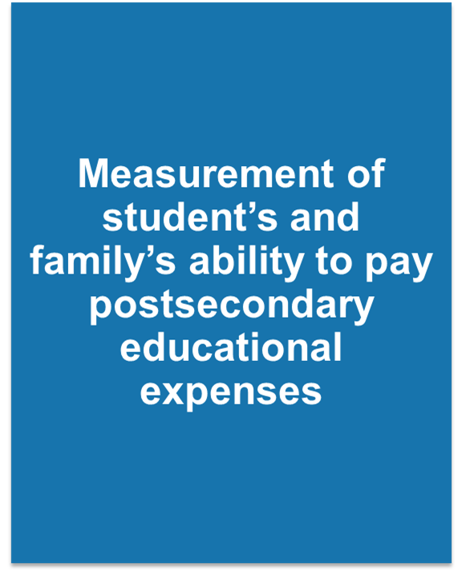
Expected Family Contribution (EFC) – From FAFSA Results

Slide 6
Expected Family Contribution (EFC)
Index number that the financial aid office uses to determine aid eligibility
Stays the same regardless of college choice
The EFC is not:
The amount of money you will pay
The amount of federal aid you will receive

Slide 7
Definition of Financial Need
Cost of Attendance (COA)
- Expected Family Contribution (EFC)
= FINANCIAL NEED

Slide 8
Financial Need Examples
Cost of Attendance | $40,000
- EFC | $15,000
= Need | $25,000
Cost of Attendance | $65,000
- EFC | $15,000
= Need | $50,000

Slide 9
College Cost Net Price
Actual cost AFTER Financial Aid is Applied
EVERY college has a Net Price Calculator on their website for you to estimate your Net Price.
Free to review anytime; no obligation; get an early estimate.
Private Colleges usually ask more questions on this calculator (for institutional aid).

Slide 10
Sources of Financial Aid
Federal – Pell Grant, SEOG Grant, Teach Grant, Work-Study, Student Loans, Parent Loans
State - New York Grant (TAP) for New York residents attending college in NY State, Excelsior.
College you attend – Scholarships, work, loans
Private/Outside Sources – Scholarships, loans, tax credits, Veterans Benefits

Slide 11
Types of Financial Aid
Grants
Scholarships
Loans
Employment Opportunities (work study; internship)

Slide 12
GRANTS
FEDERAL
STATE
PELL Grant
EFC below 5486
$0 to $6345 (2020-21)
SEOG Grant
TEACH Grant
TAP – any NY college
NY Net Taxable Income below $80,800
NY Programs
Excelsior - SUNY
STEM – SUNY school – top 10%

Slide 13
Scholarships
Your College
Review Website for merit, need, application
High School
Civic Groups or Businesses
Places of Employment
Free Internet Searches
Example:
www.fastweb.com

Slide 14
Federal Direct Student Loan
Subsidized – 2.75% Interest rate (in 2020-21).
Based on need (COA – EFC – other aid = Financial need)
Federal government pays interest while student in school
Freshman may borrow up to $3,500
Unsubsidized – 2.75% Interest rate (in 2020-21).
Not based on need
Student is responsible for interest while in school
Freshman may borrow up to $5,500 minus any subsidized loan money (ideally - $3,500 subsidized and $2,000 unsubsidized)
Repayment begins 6 months after graduation

Slide 15
Parent Loan for Undergraduate Students (PLUS)
Loan in parent name
Credit Check – No Adverse Credit
5.3% interest rate (2020-21)
Interest accrues at disbursement
Payments right away
Limits
Up to COA minus other aid.

Slide 16
Work Opportunities
Federal Work Study Program (FWS)
Need Based
Limited hours
Usually minimum wage
Helps with personal expenses
Each college has own process; jobs usually on campus or in community service.

Slide 17
HOW TO APPLY FOR FINANCIAL AID
Complete Federal Process – start at studentaid.gov
Complete NY STATE Process – start at hesc.ny.gov
Complete process and any requirements at each college – check their websites – talk with Admisisons/Financial Aid Staff
Search Private Scholarships

Slide 18
How to Apply for Federal Financial Aid
Go to studentaid.gov for complete information on federal financial aid programs and applying
Request an FSA ID for the student and parent (Anytime Now)
Collect information
Complete FAFSA online: sometime after October 1st

Slide 19
FSA ID fsaid.ed.gov
Username and password
Legal signature on the FAFSA
Access to other U.S. Department of Education sites
Student and 1 parent need an FSA ID
Email address and mobile phone number cannot be used with more than one FSA ID

Slide 20
Collect Information
Student and parents’ SSN and DOB
Parents’ marital status
FSA ID for student and parent
W-2s and tax returns for student and parents
Records of untaxed income for student and parents
Bank accounts, stock, real estate and business record for
student and parents
Student’s driver’s license number
Student’s alien registration number (non-U.S citizens)

Slide 21
File the FAFSA studentaid.gov
Applications accepted starting October 1
File each year for each student in college
Results Produce the EFC
Use income from 2 years prior
2019 income for the 2021-22 FAFSA

Slide 22
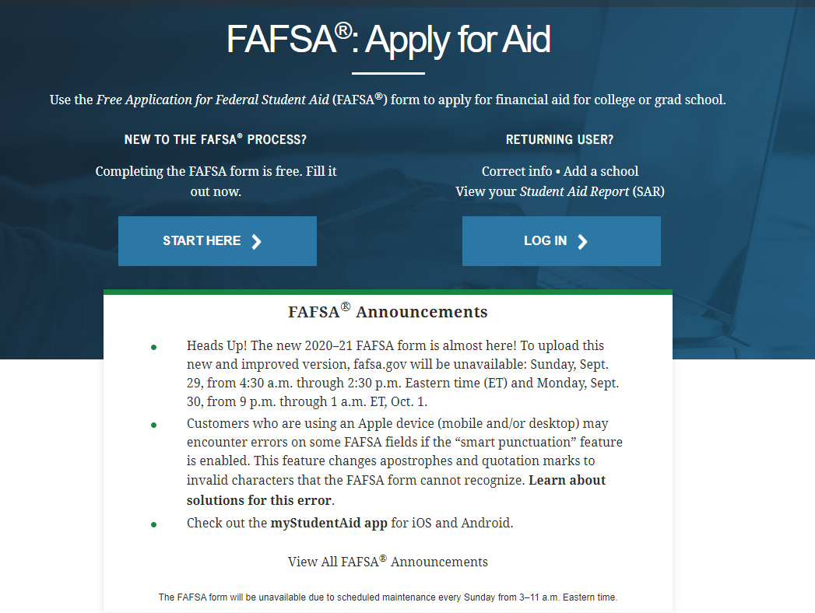
FAFSA on the Web

Slide 23
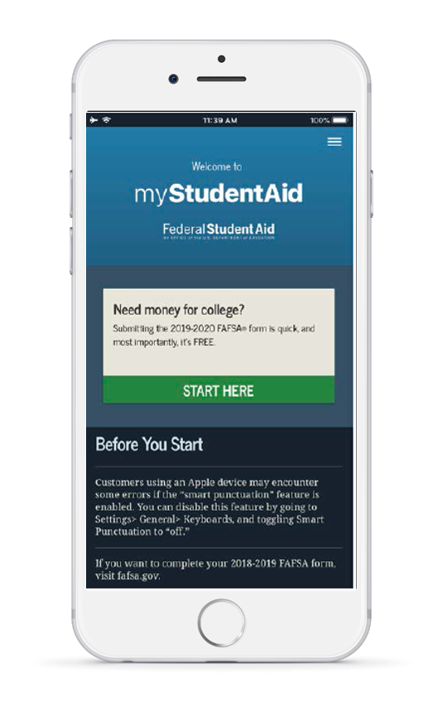
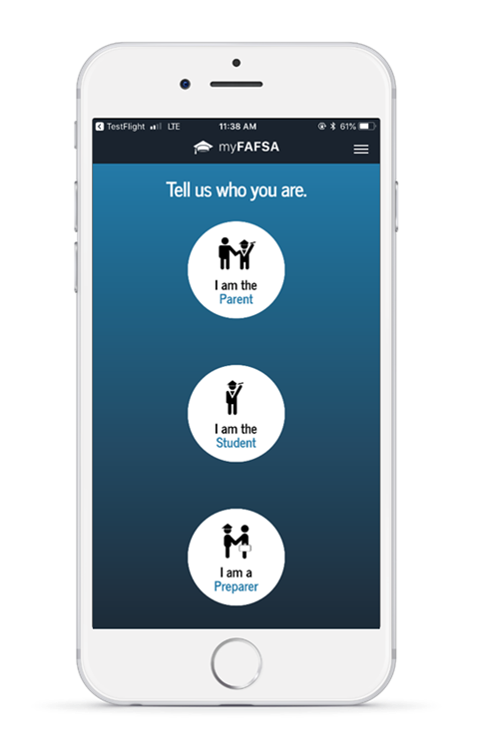
myStudentAid Mobile App
Android or Apple
Must have FSA ID
Save, complete & submit the FAFSA
IRS DRT available

Slide 24
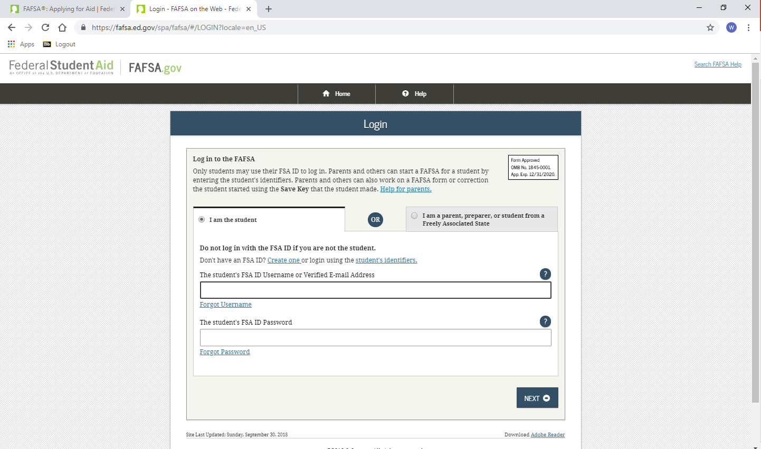
Sign in using student FSA ID

Slide 25
Steps for Filing the FAFSA
Step One: Student Demographics
Name, social security number, birth date
Provide an email address
Indicate gender
Males have the opportunity to enroll in
Selective Service
For more information go to: www.sss.gov
Step Two: School Selection
Enter FAFSA codes – up to 10 colleges
Indicate housing status while in college

Slide 26
Seven Steps for Filing the FAFSA
Step Three: Dependency Status
Generally Dependent if under age 24
Independent if:
Married
A graduate student
Serving in the U.S. military or a veteran
Supporting children or other dependents
Has a court appointed legal guardian
Has been determined homeless or at risk of
being homeless
Step Four: Parent Demographics
Name, social security numbers, birth dates
Marital status
If Separation or Divorce–current family unit (parent student lives with the most)
Step Five: Financial Information
Use 2019 tax returns for 2021-22
IRS Data Retrieval
Income and Asset Info – Parent and Student

Slide 27
IRS Data Retrieval Tool
Applicants may submit a real-time request for IRS tax data.
The IRS will authenticate the taxpayer’s identity.
If a match is found, the IRS will send the results in real-time.
Applicants may choose whether or not to transfer the data.

Slide 28
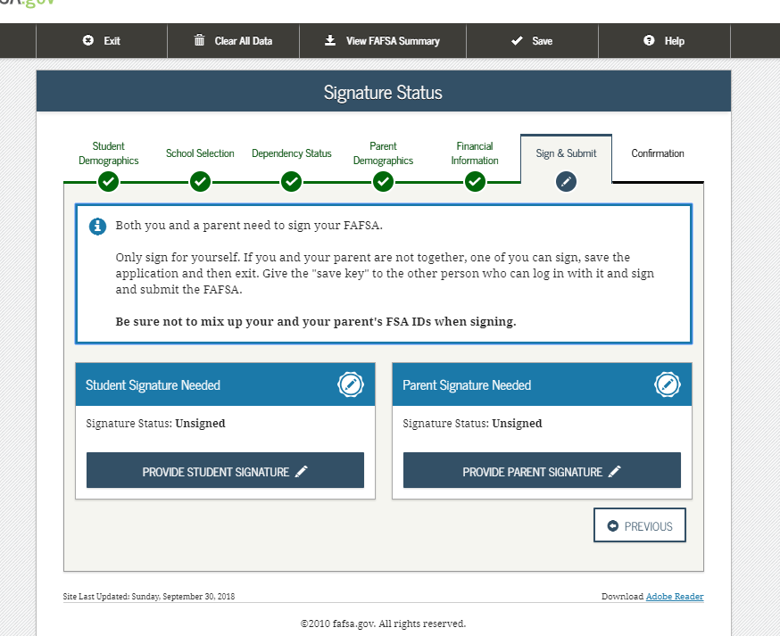
Seven Steps for Filing the FAFSA
Step Six: Sign and Submit using the FSA ID
Sign electronically

Slide 29
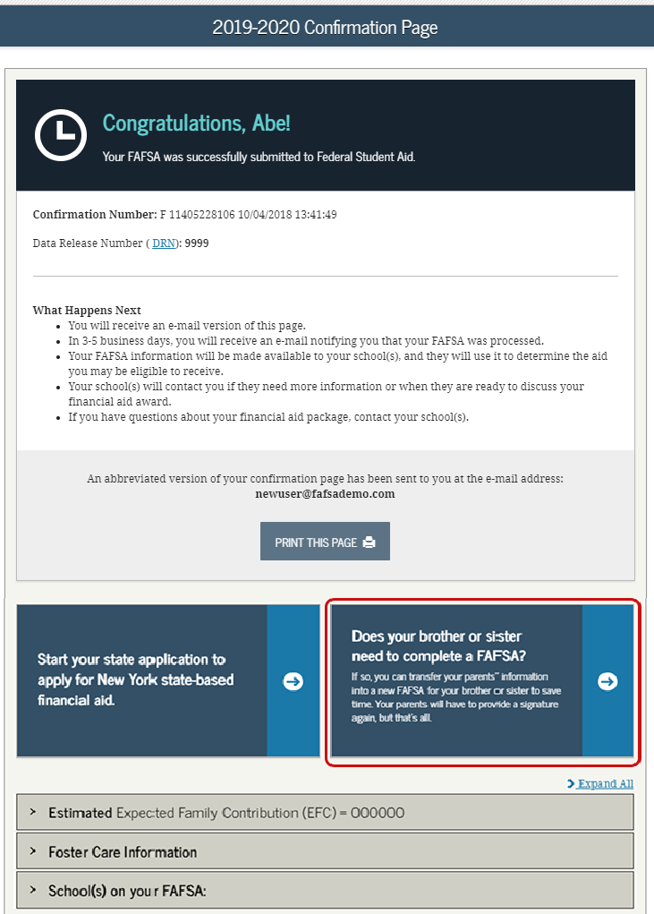
Seven Steps for FAFSA
Step Seven: Confirmation

Slide 30
How To Apply
Complete TAP Online
https://www.hesc.ny.gov
After completing FAFSA online, from the confirmation page, link to the TAP-on-the-Web.
Establish student HESC PIN.
Student and Parent e-sign at end of application.
Must re-apply each academic year.

Slide 32
Apply for Excelsior (if available) If SUNY or community college in NY State
To be notified when (if) the application becomes available
Sign up for the HESC alert at www.hesc.ny.gov/excelsior
Same application site as TAP

Slide 33
Excelsior Scholarship
Began Fall 2017
How it works:
Award equals max of SUNY Tuition minus any amounts received for TAP, Pell or other scholarships
Earn 30 Credits Per Year
Live and work in NY after college
$125,00 was income limit in 2019-20

Slide 34
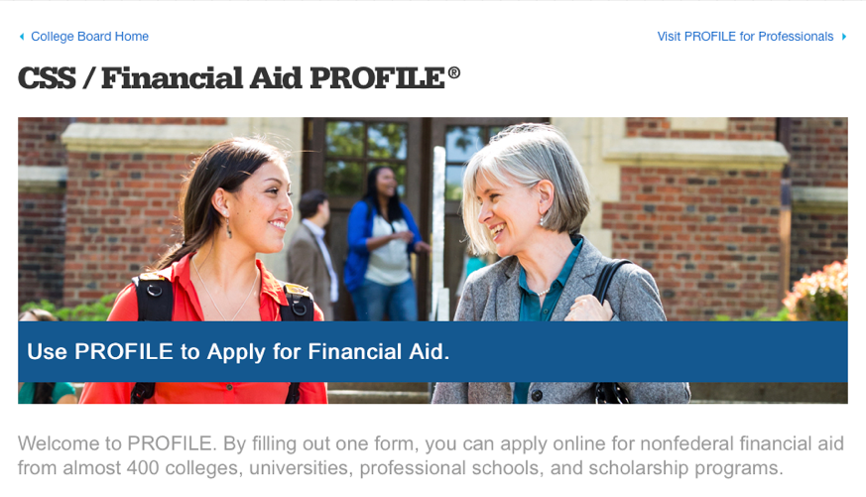
CSS/ Financial Aid PROFILE
The PROFILE is a form that allows students to complete one form and apply online for non-federal financial aid from almost 400 colleges, universities, professional schools, and scholarship programs. Check with school – usually just highly competitive private colleges. Opens October 1st.
https://student.collegeboard.org/css-financial-aid-profile

Slide 35
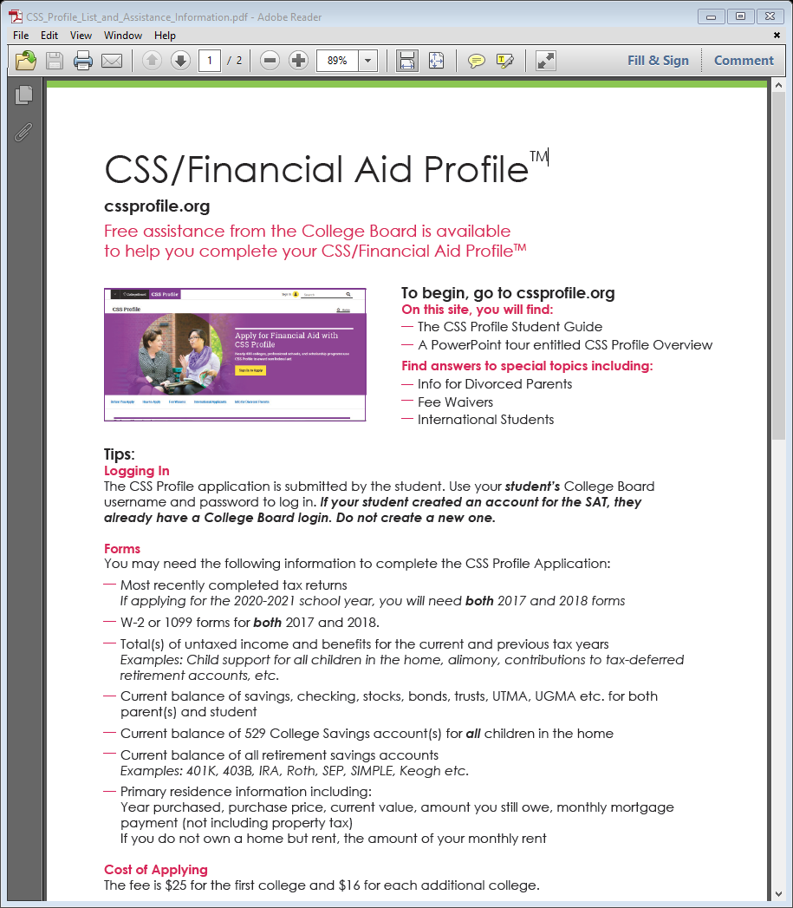

Slide 36
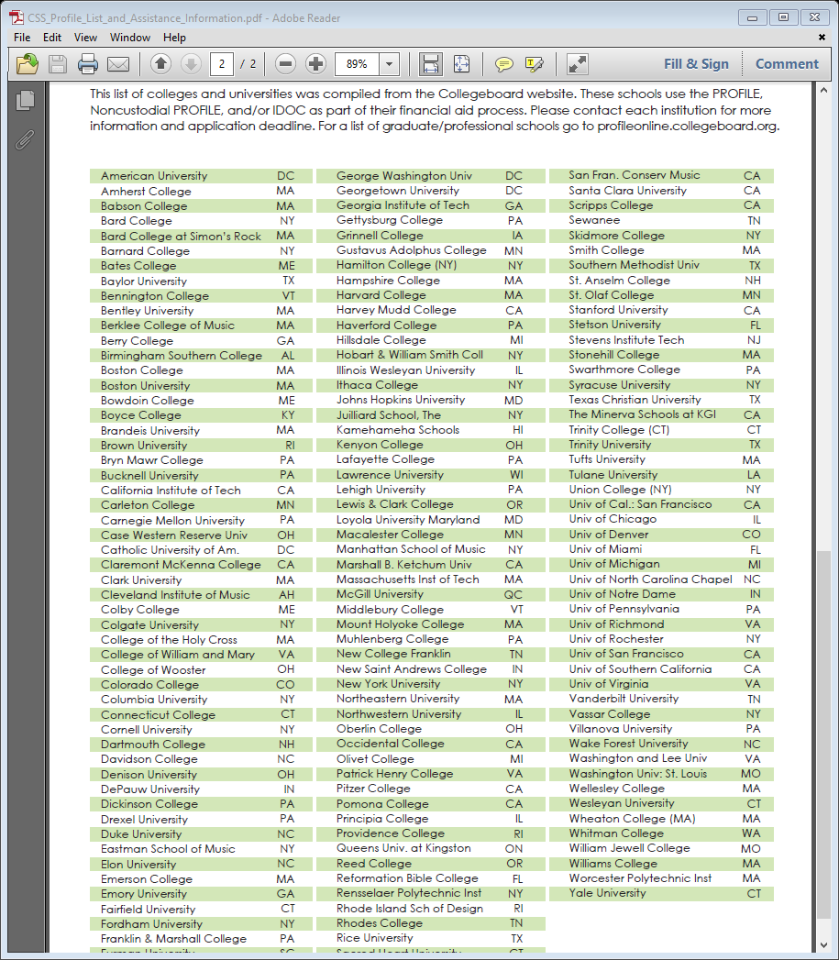

Slide 37
When To Apply for 2021-22
FSA ID – Now or Near Future
Scholarship Searches – Now/Ongoing
FAFSA – Anytime after October 1, 2020; Before school deadline.
Check school websites
TAP – After the FAFSA.
Other Forms??
Excelsior for SUNY; CSS Profile some privates
Some schools may have separate form for their own scholarships, etc…

Slide 38
Watch for Results & Communicate with Financial Aid Office
FAFSA Results will be available in 3-5 days - EFC
Schools May Ask for Follow up Forms or Documents – To Verify Reported Information.
Each Schools timing will vary.
Eventually Receive Financial Aid Offer Letters from Accepted Schools.

Slide 39
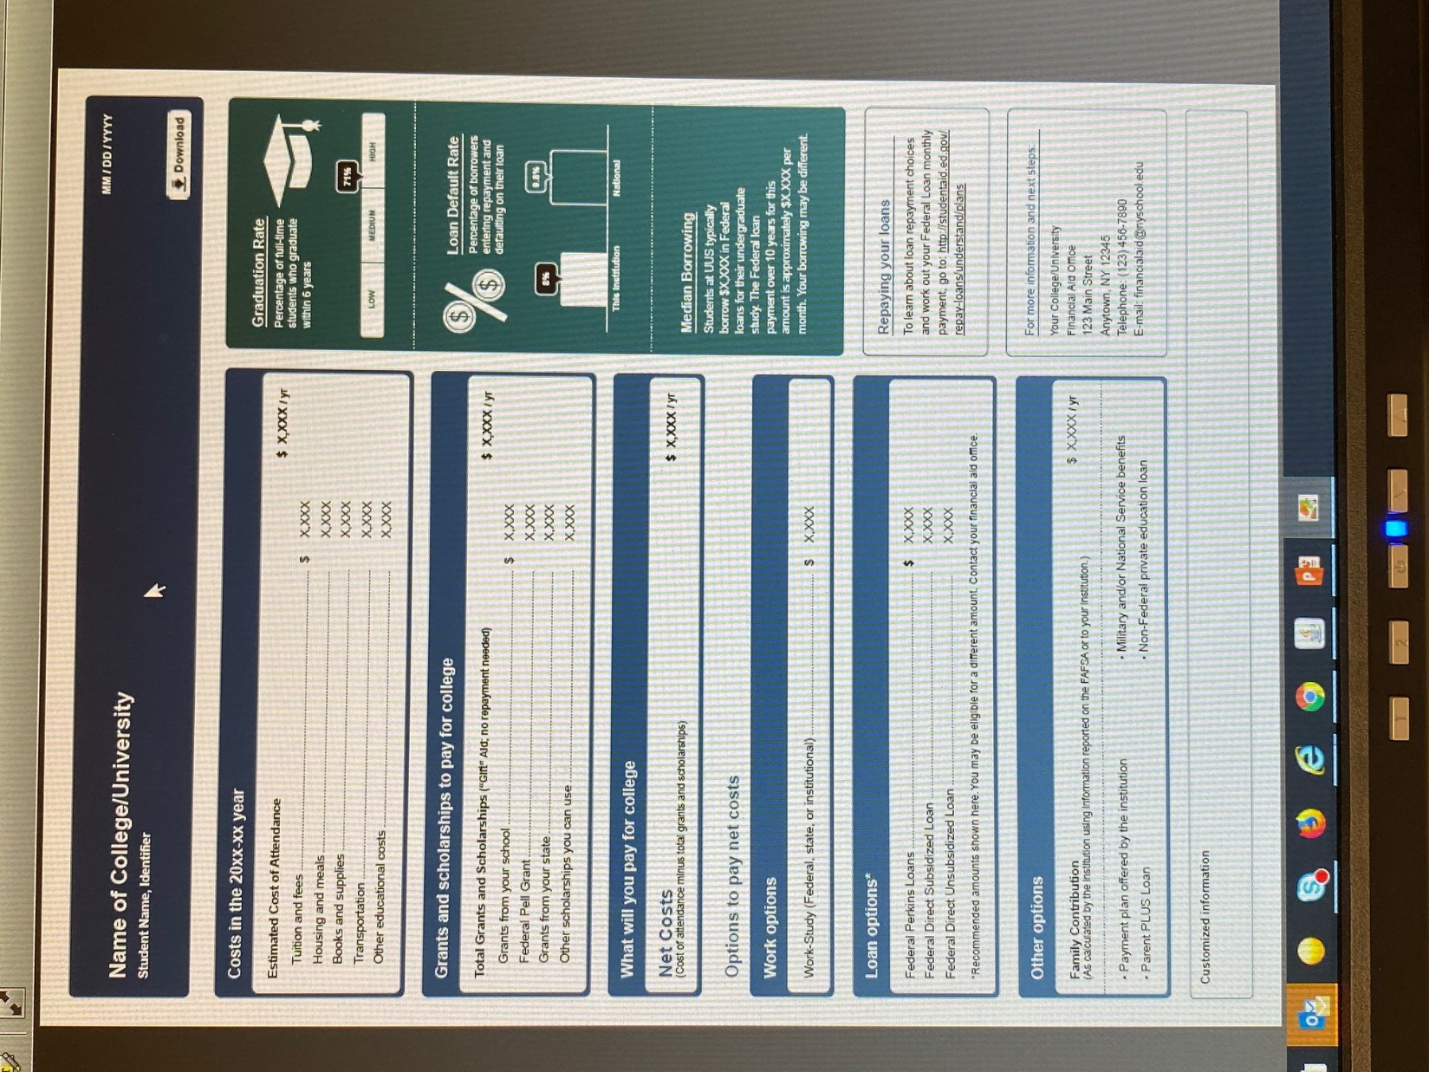

Slide 40
Strategies - Preparation
Keep Organized – be ready to follow up
System to remember FSA ID; folder for documents; etc…
Meet Deadlines!
Parent/Student Communication
E-mail checking
Follow up
FERPA – Student has to grant access for parent to interact with school
Compare – Make Charts?
Required forms and dates for each school

Slide 41
Strategies - Financing
Payment Plan as opposed to Alternative Financing or Parent Loan.
Savings – 529 plans
Appeals based on unusual circumstances or changes in situation AFTER FAFSA is filed.
Is 2020 or 2021 income lower than 2019?
Individual to each college
Limit Borrowing; compare net costs
Reduce costs – books and supplies; complete on time; set budgets

Slide 42
Questions
Jerome St. Croix, Director, Financial Aid
Monroe Community College
jstcroix@monroecc.edu

